Slide 1
EY Internship PROJECT OVERVIEW - ALFA

Slide 2
PROJECT DETAILS
Project Coordinator: ABHISHEK SINGH
Backend: HARSHIV PURI
Frontend: APURV SHARMA
Project Details: [...]

Slide 3
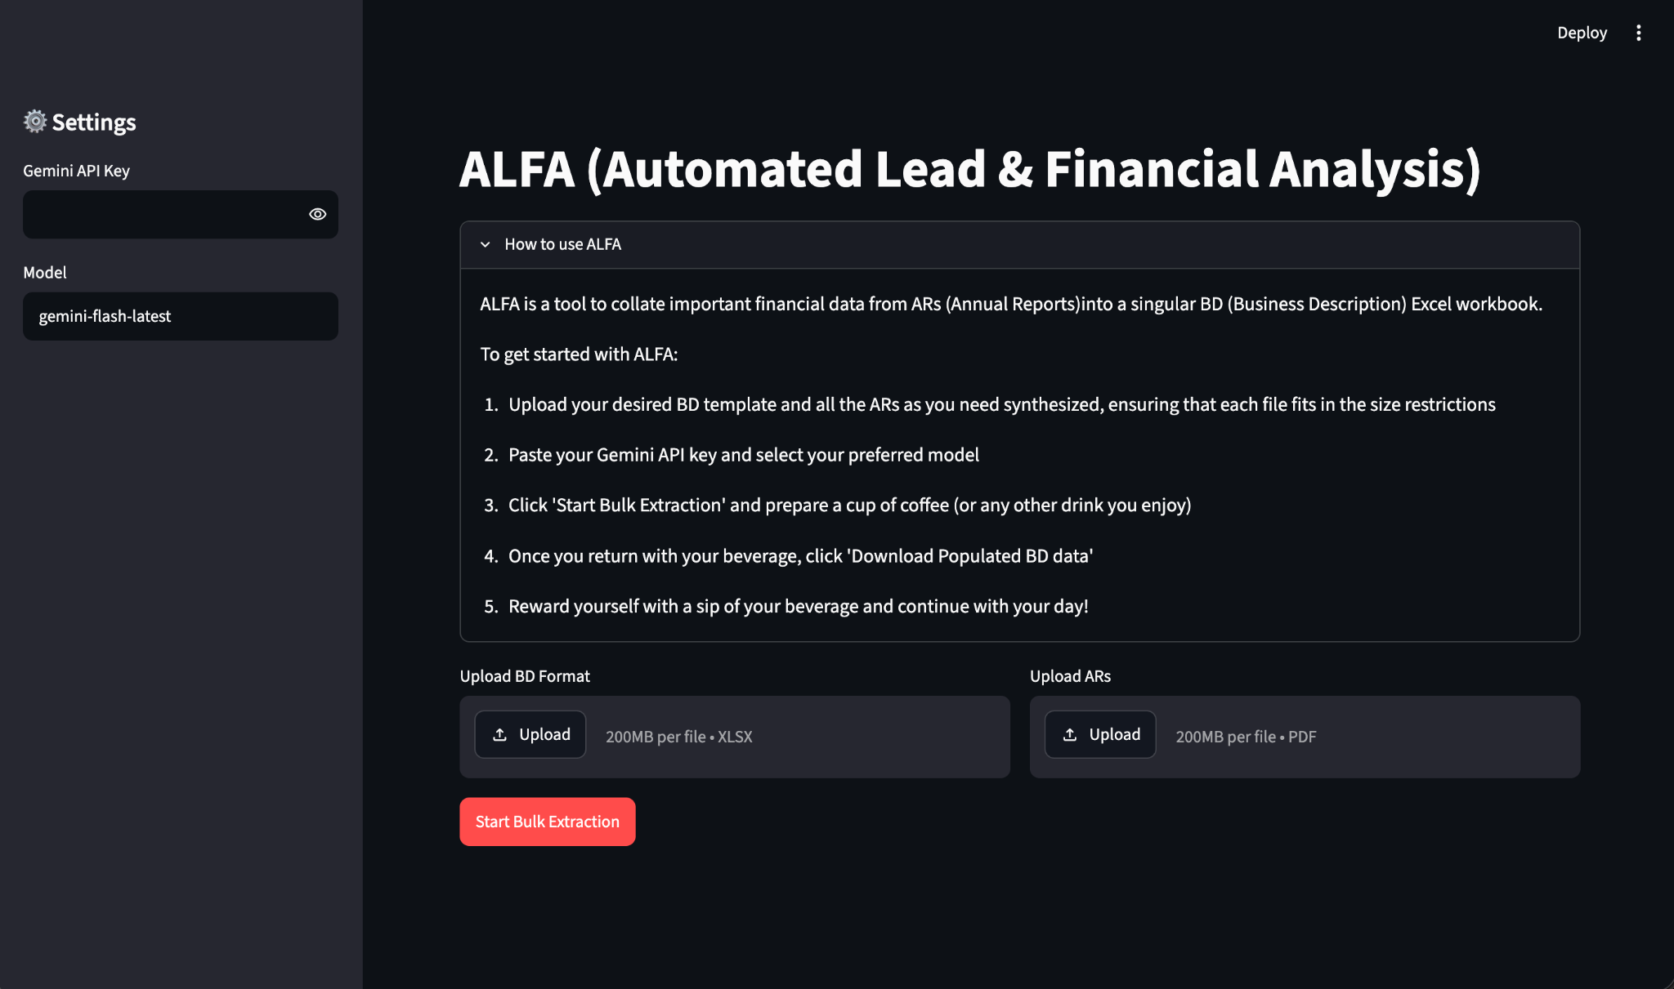
PRODUCT: Automated
Lead &
Financial
Analysis
Automatically fills out Business Description (BD) forms from a given format and a collection of Annual Reports (ARs)

Slide 4
CURRENT LIMITATIONS
Free API access
  Low token quotas (TPM, RPD) = limited functionality for multiple simultaneous ARs
  No websearch = no autofill of website/LinkedIn
Enterprise API key solves both

Slide 5

DEMO VIDEO

